Slide 1
WordPress tutorial
IoTEDU

Slide 2
1. readability

Slide 3
Try to make your sentences shorter

Slide 4
Transition words

Slide 5
Write In active voice

Slide 6
Consecutive sentences

Slide 7
Use subheadings

Slide 8
Paragraph length

Slide 9
Sentence length

Slide 10
2. SEO

Slide 11
How to give a focus key phrase
The focus key phrase should be maximum 4 words
All the words must be present in the title of the post as well as the meta description
The focus key phrase must be present at least 4-5 times in the post but not more than 7 times.

Slide 12
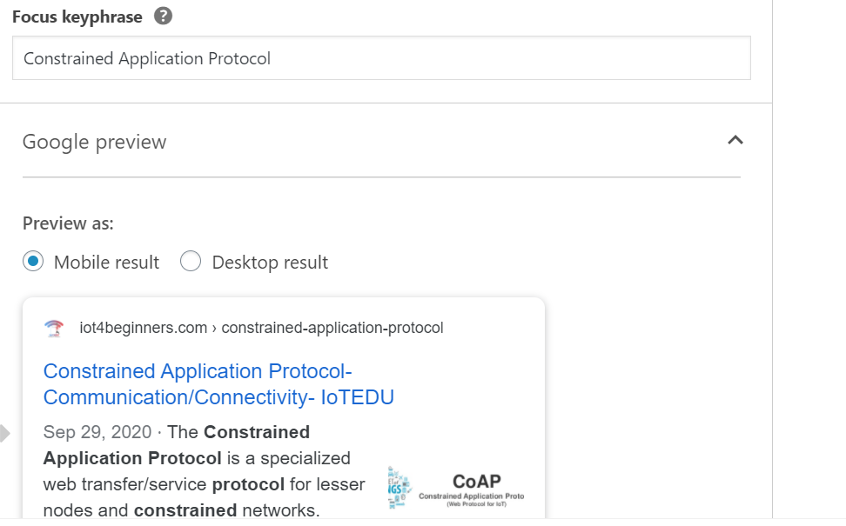
How to give a focus key phrase - example
Meta Description

Slide 13
How to give seo title

Slide 14
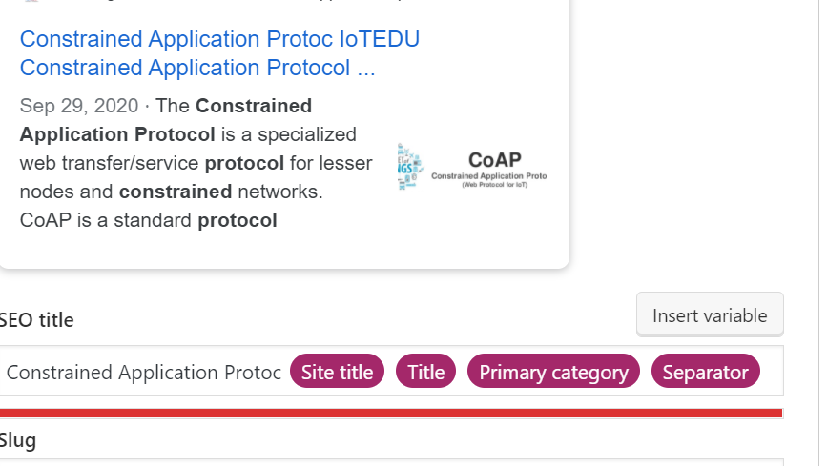
Wrong seo title

Slide 15
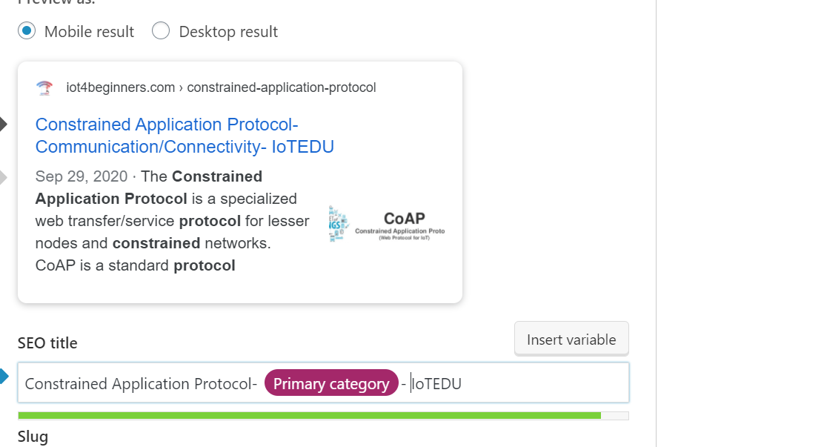
Correct seo title

Slide 16
How to get a green in seo?

Slide 17
Add internal and external links

Slide 18
Don’t overuse the keyword

Slide 19
Only the title heading should have H1, other headings and sub headings should have above h2-h6

Slide 20
Key phrase length

Slide 21
Wrong internal link

Slide 22
Easy method to give an internal link
Double click on the keyword. Click on the hyperlink symbol.
Write the keyword on the search, and select an appropriate link.
Click here

Slide 23
Correct internal link

Slide 24
3. Document (sidebar)

Slide 25
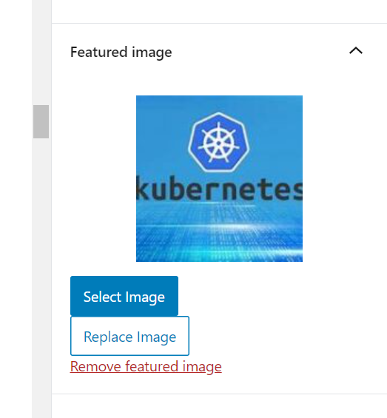
Featured image should always be set here

Slide 26
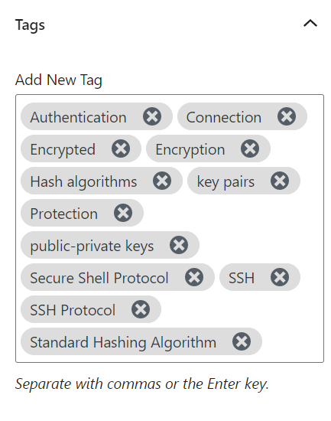
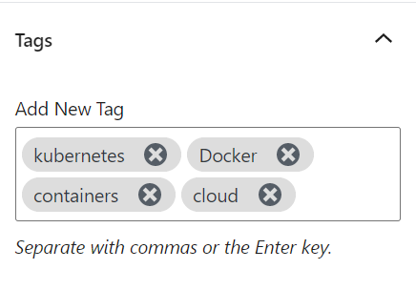
Add tags to the post

Slide 27
Do not add category

Slide 28
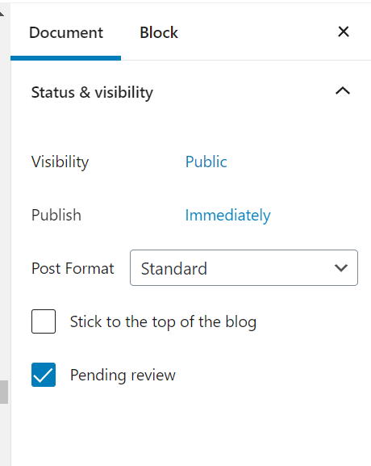
Always set the post in pending review

Slide 29
4. Post

Slide 30
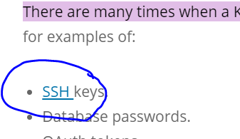
Use hyperlinks instead

Slide 31
Do not give space before a paragraph starts

Slide 32
Do not give any third-party videos

Slide 33
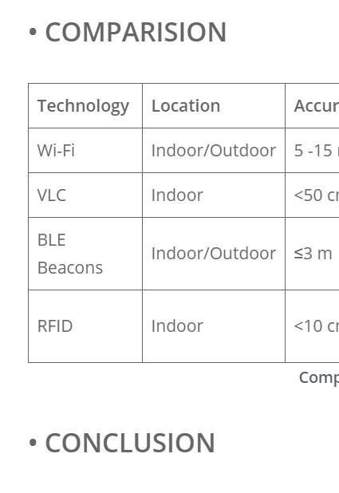
Don’t give bullet point for headings

Slide 34
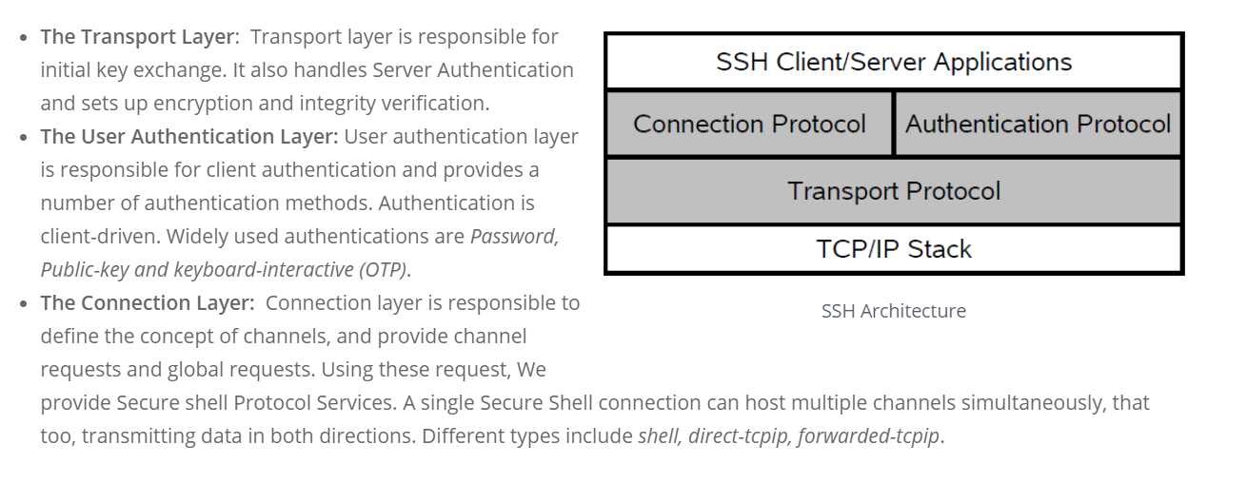
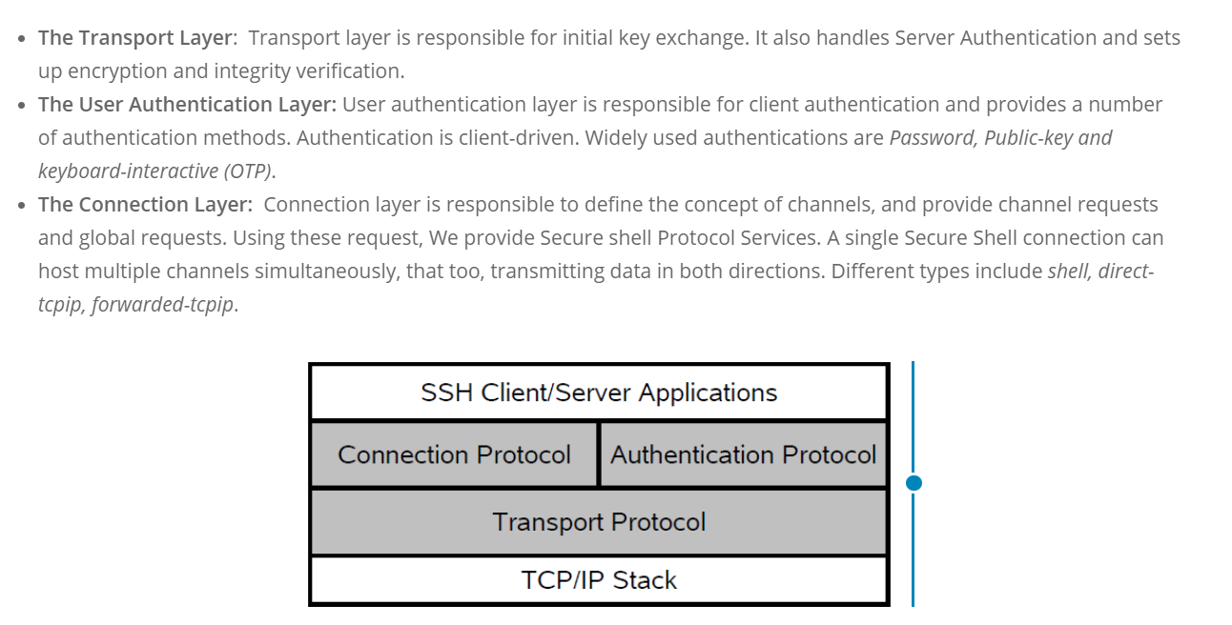
Do not place the image on the left or right

Slide 35
Do not change the color of the headings, divi template will automatically set the colors
Wrong
Correct

Slide 36
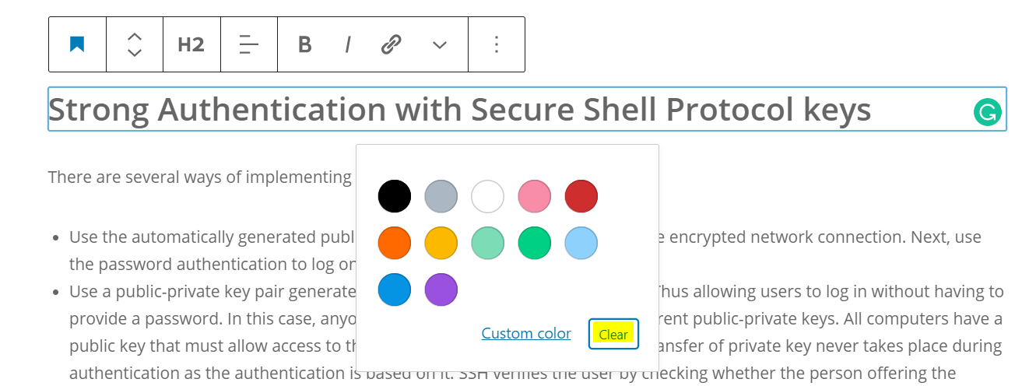
If you have done that please click clear

Slide 37
Use Grammarly

Slide 38
Click on the word, Grammarly suggests an alternate word

Slide 39
Do not use buttons for hyperlinks

Slide 40
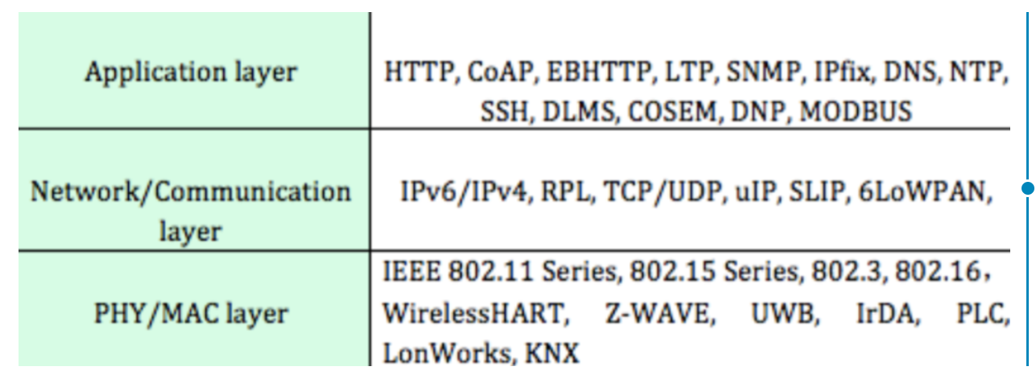
Give high quality images

Slide 41
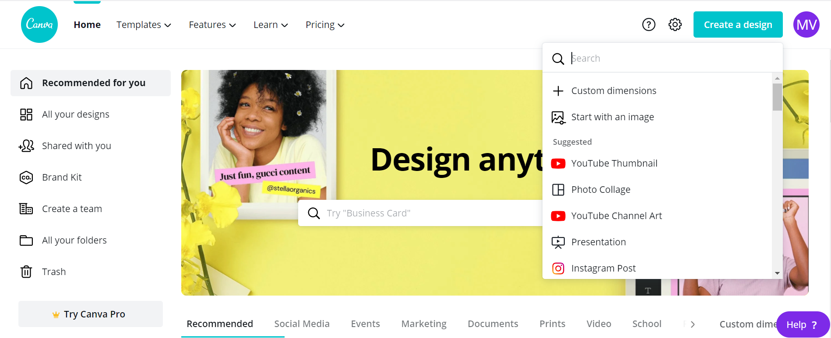
How to use canva?
Select this option

Slide 42
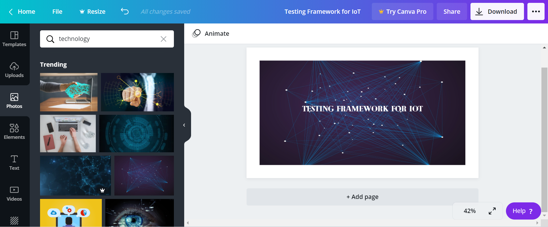
Use canva for featured image if you did not find any suitable image

Slide 43
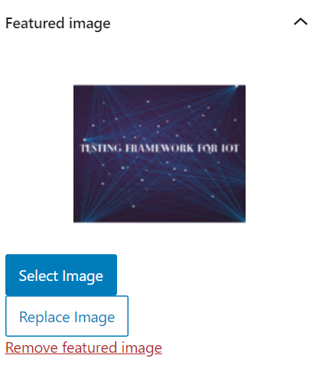
The words must fit inside the thumbnail

Slide 44
Check the heading score. Should be above 50

Slide 45
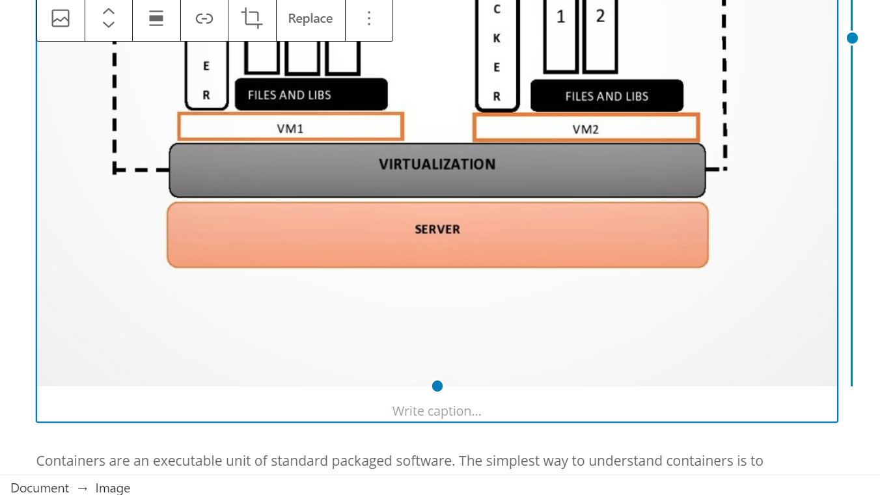
Give Image Caption and source

Slide 46
Best headline score

